Slide 1

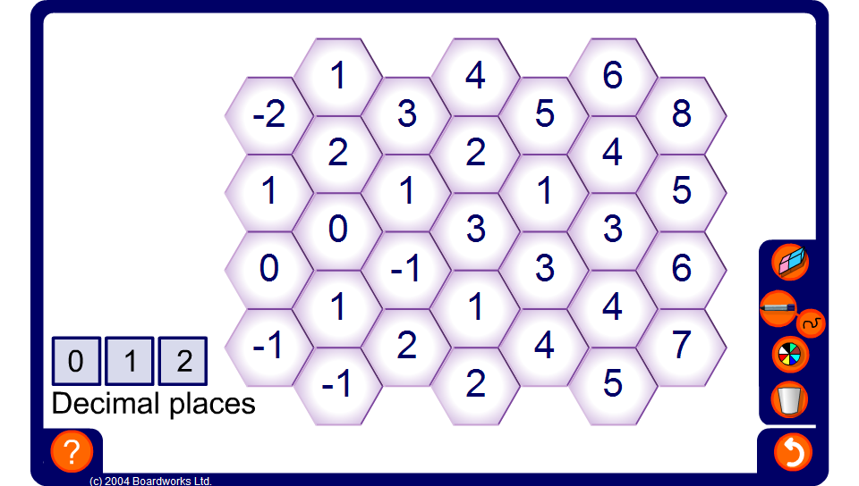


Ordered Paths
Notes:
The object of the activity is to select a starting number on the far left and to find a path from left to right. You must always move into a hexagon containing a smaller integer.
Ask pupils to come to the board to show possible paths.

